Slide 1


Student Loan Crisis Rutgers boot camp project
Team : Tom, Terry,Nrupesh, Mugdha
1

Slide 2

Student Loans- Project Details
The purpose of this project is to analyze how much is the outstanding student loans in USA . To acheive this analysis, we have pulled data like cost of school, default rate , repayment rate and earings and total monthly repayment rates from the college scorecard for schools and universities across USA.
After extracting the dataset, we have used geomapping and plotly to map and compare multiple data set
The google JS library was used to plot scatter plot diagrams.
The SQL Db was used as database connection .
Data from following sites was used
https://lendedu.com/blog/average-student-loan-debt-statistics
https://collegescorecard.ed.gov/data/documentation/

Slide 3



Statistics on Student Loans
$1.52 trillion the total amount of outstanding student loan debt
45 million the total number of student loan borrowers
$102 billion the total amount of private student loan debt
Over 7 million (>2%) of the U.S. population has defaulted on their student loans
Student loan debt is the second highest form of debt in the U.S., second only to mortgages
Over 73% of borrowers have delayed saving for retirement because of their debt
Around 63% of borrowers have delayed buying a home because of their debt
As of Q42018, $65.2 Billion was outstanding for the age group 62 and older
For the Class of 2017, of the 250 colleges with the highest amount of student loan debt per borrower, 81.6% of the institutions were private.
3

Slide 4
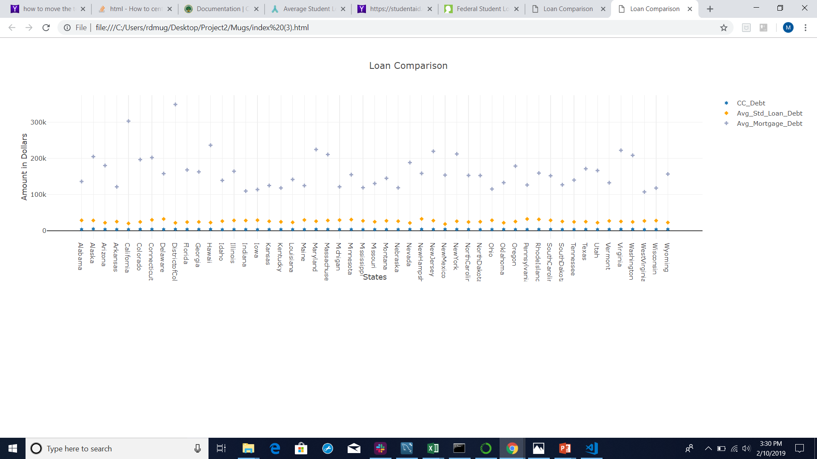
Student Loan comparison with Credit Cards & Mortgages for each state per person
4

Slide 5
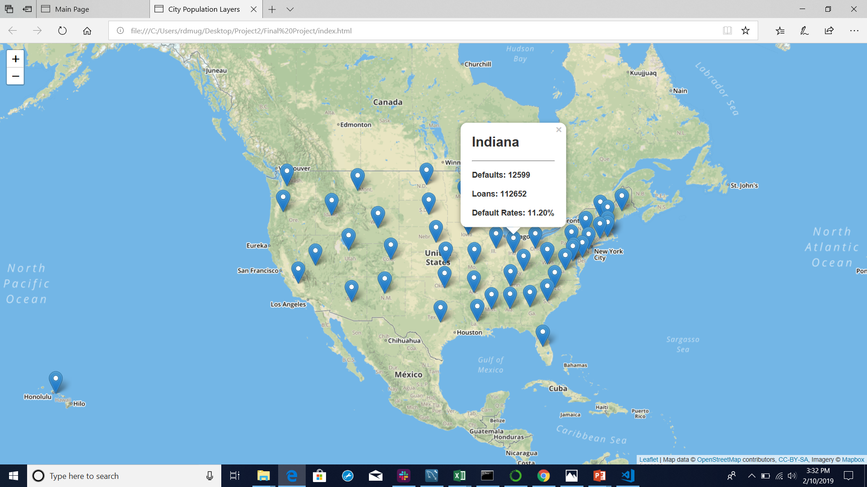
Students loans Amount , Defaults in Percentage and absolute terms across USA
5

Slide 6
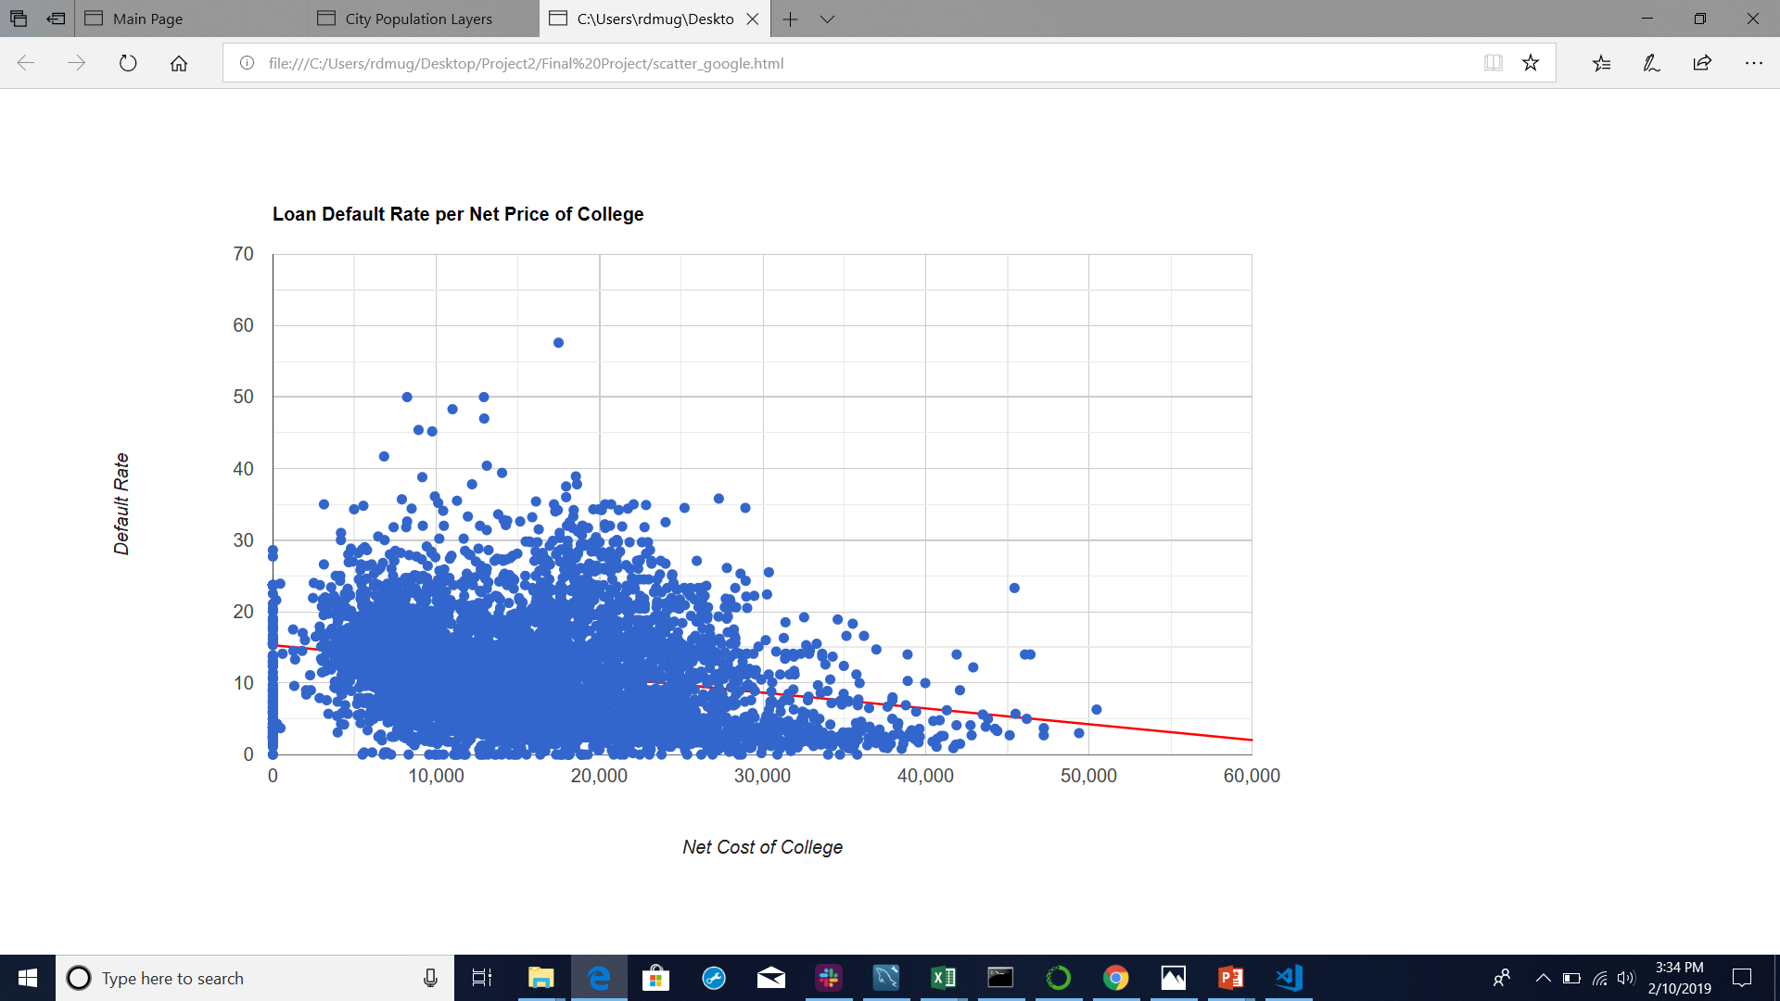
Scatter Plot- Loan default rate per net price of college
6

Slide 7
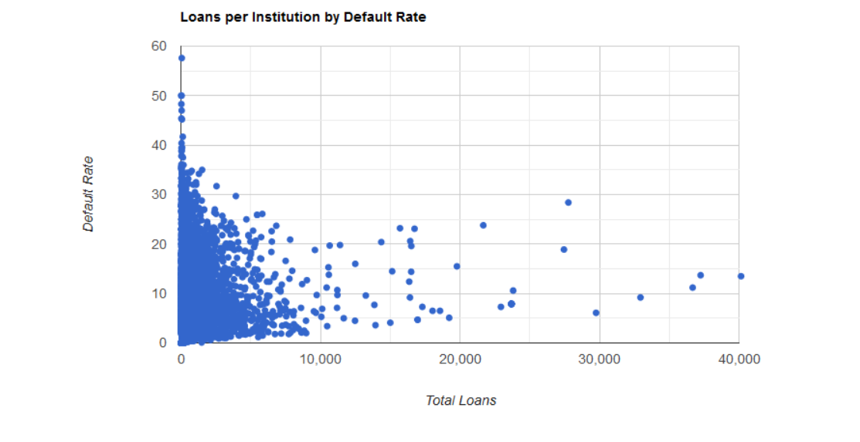
Students loan defaults per Institution
7

Slide 8



Thank You
8

